Slide 1
Fraud Detection Model: Data‑Driven Approach to Reducing Financial Risk
Prepared by: Gideon

Slide 2
Executive Summary
Achieved high precision and strong recall on minority fraud class
Built a machine‑learning model to detect fraudulent transactions
Analysed behavioural, temporal, and transactional patterns
Engineered features to capture risk signals (time, device, IP, velocity, corridor risk etc.)
Trained and evaluated Logistic Regression, KNN and Random Forest
Achieve high precision and strong recall on minority fraud class
Model shows strong potential to reduce fraud losses and operational

Slide 3
Project Overview / Problem We’re Solving
The Business Problem
Fraudulent transactions cause direct financial loss
Fraud undermines customer trust and increases operational overhead
Fraud patterns evolve quickly and are difficult to detect manually
Our Goal
Build a machine‑learning model that detects fraud early and accurately.
Prioritise recall to minimise missed fraud.
Provide a scalable, automated fraud‑screening system.

Slide 4
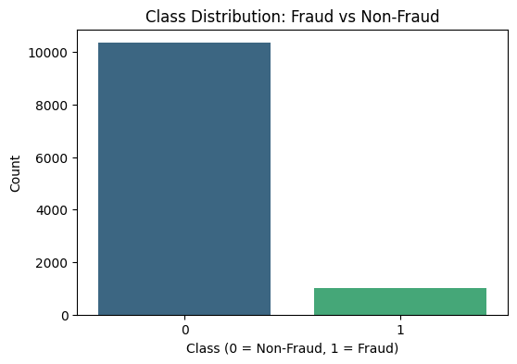
Core Decisions We Made
Data & EDA‑Driven Decisions
Severe class imbalance → accuracy alone is misleading.
Fraud patterns found in amount, time, weekday, device/IP behaviour.
Engineered features: time encodings, weekend flag, velocity, device trust, corridor risk, missingness indicators.
Modelling Decisions
Pipelines to prevent leakage.
Logistic Regression + Random Forest selected.
Random Search for hyperparameter tuning.
Metrics focused on recall, precision, F1,F2, ROC‑AUC.

Slide 5
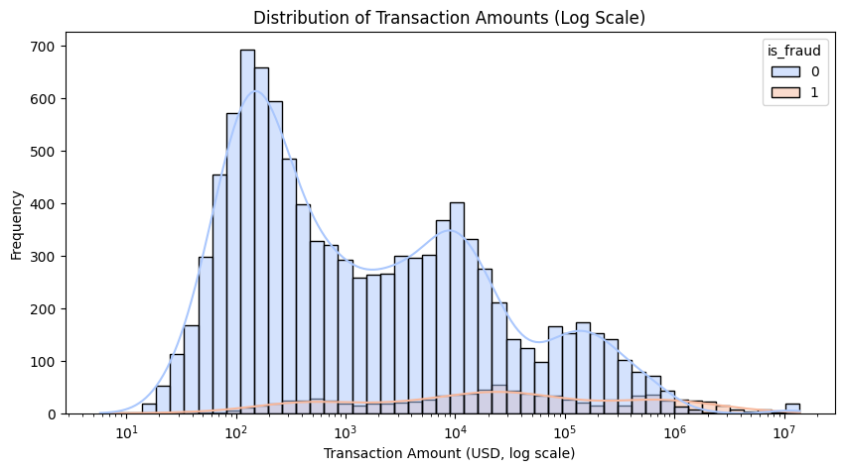
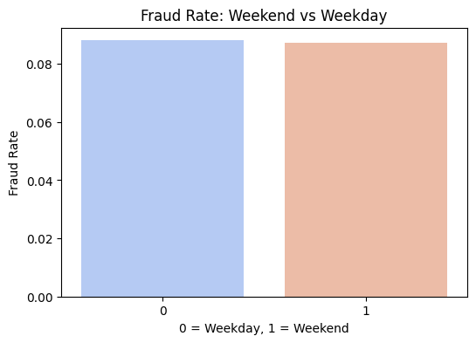
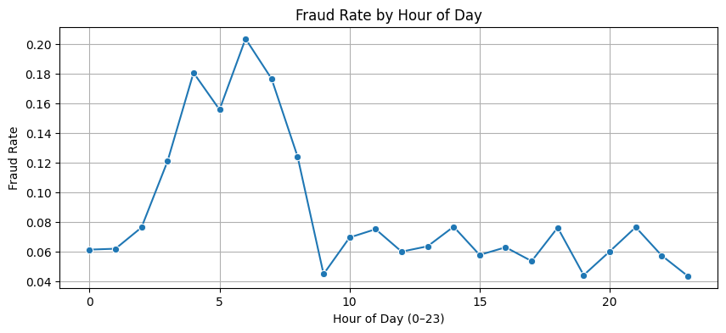
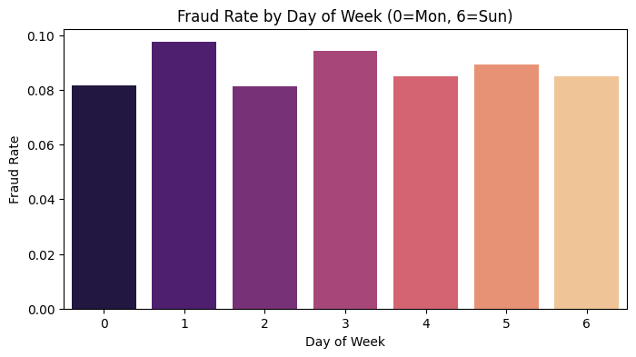
Key Insights From the Data
Behavioural Insights
Fraud spikes between 4–6 AM → low‑monitoring hours.
Fraud varies by weekday (highest on Tuesday).
Fraudulent transactions show higher median amounts and wider spread.
Weekend vs weekday fraud rates are similar → fraud is continuous.

Slide 6
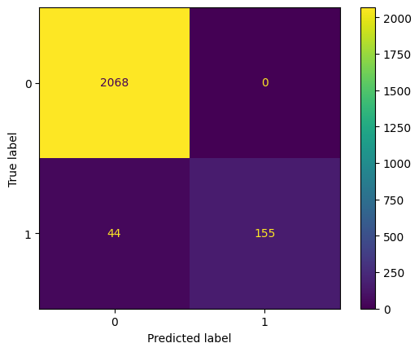
Cost Implications of Deploying the Model
Model Impact
High recall reduces fraud losses.
Zero false positives preserves customer experience.
Automation reduces manual review workload.
Expected significant reduction in fraud‑related costs.
Cost of False Negatives (Missed Fraud)
Direct financial loss
Chargebacks
Regulatory exposure
Customer trust erosion
Random Forest Regression
Logistic Regression

Slide 7
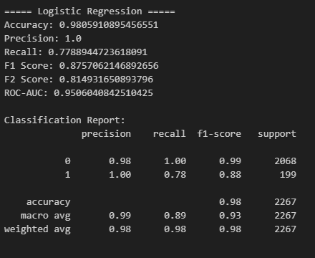
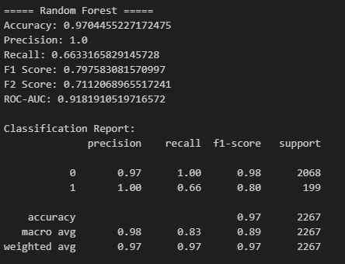
Recommendations & Next Steps
Recommendations
Deploy Logistic Regression as the primary model (best recall + ROC‑AUC).
Tune decision thresholds to further increase recall.
Add XGBoost in next iteration for improved performance.
real‑time monitoring for model drift.
Expand behavioural features ( device fingerprinting).
Next Steps
Integrate model into transaction pipeline.
Build fraud monitoring dashboard.
Conduct A/B testing with real traffic.
Measure fraud savings post‑deployment.

